Slide 1
Protective Rig Covers
Making custom dust covers for your rigs
by
KI7LXI
Sheila Theriault

Slide 2
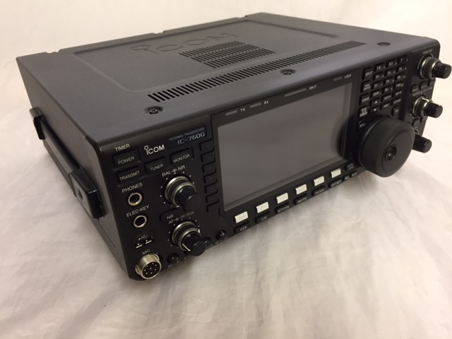
Measure the Rig
Measure Top of Rig front to back and side to side
Width and Depth
Include space for Knobs/Controls
Measure height of each side.
Add 1/2” to height for a hem.
To size fabric
Add left side, top, width and right side; 7” + 11” + 7” = 25”
Add front, top depth, rear; 7” + 13” + 7” = 27”
Total fabric required is: 25” x 27”
IC7600 | Width | Depth | Height
 | 11” | 13” | 6.5”
hem |  |  | .5
Total | 11” | 13” | 7”

Slide 3
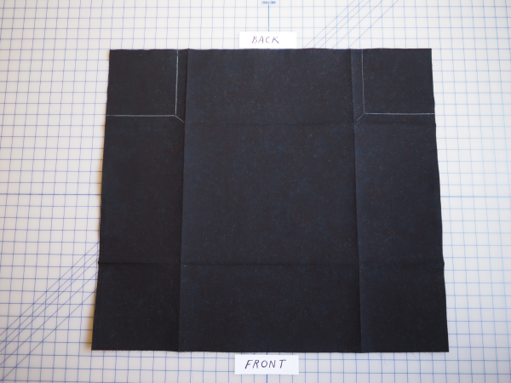
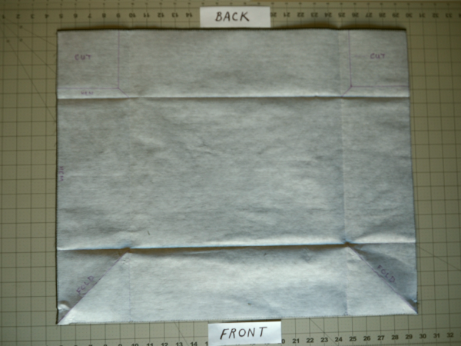
Cutting & Stabilizer
For our sample (IC-7600) we need piece of fabric that is 25”W x 27”L
Use of stabilizer will add some stiffness to finished cover.
Stabilizer used for this project: Pellon 809 Decor Bond
Cut stabilizer to same size as fabric
Adhere stabilizer to fabric as per manufactures instructions.
Use plenty of heat and steam
Sometimes a damp press cloth helps

Slide 4
Measure and Mark Alignments
Draw a line 7” inside from each edge (for this example)
Fold fabric along this line using your iron

Slide 5
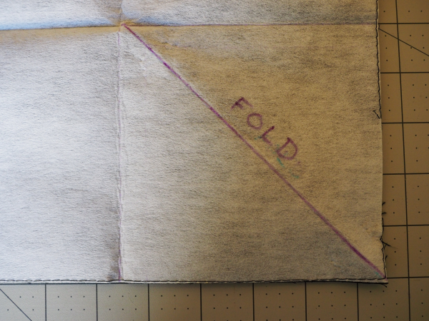
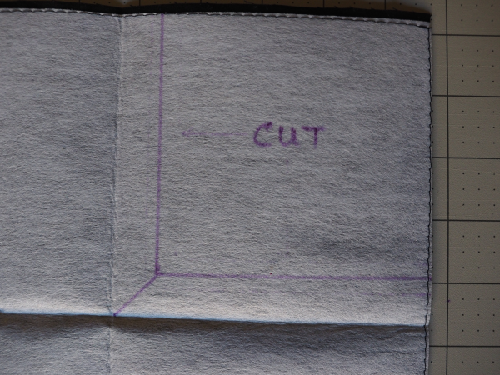
Adding Cut & Fold Lines
Front Corner
For the front corners, draw a 45° line diagonally for each of the two front corners
Rear Corner
For the rear corners, draw a line 1” from the fold line to make a corner cut
This is for the rear flap

Slide 6
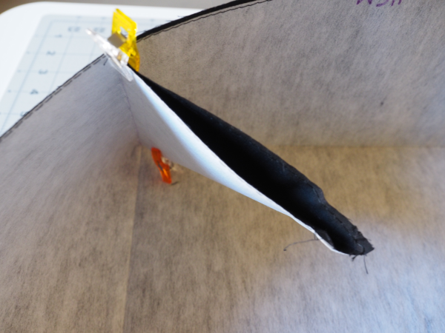
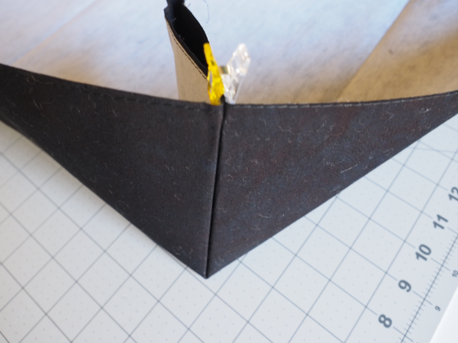
Pin or use Clips
Press with iron along each fold line to form a corner.
Secure using pins or clips along each fold line
Clips are fast and save your fingers !

Slide 7
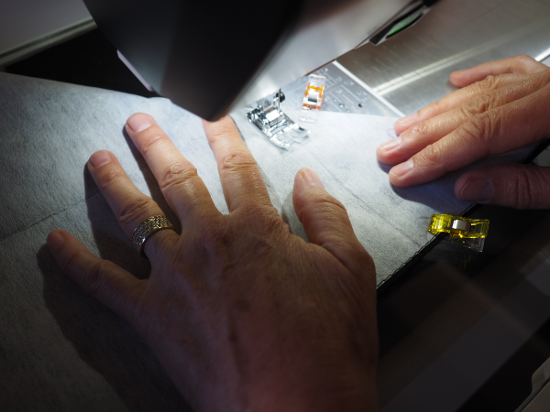
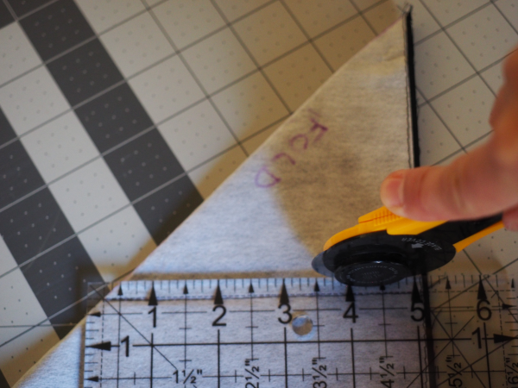
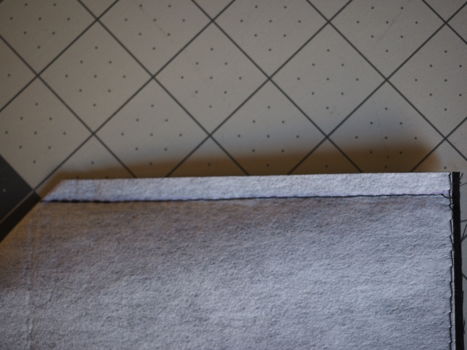
Stitch Fold Line and Trim
Reverse your corners inside out
Then stitch along fold line
Trim excess leaving 1/4” along stitch line

Slide 8
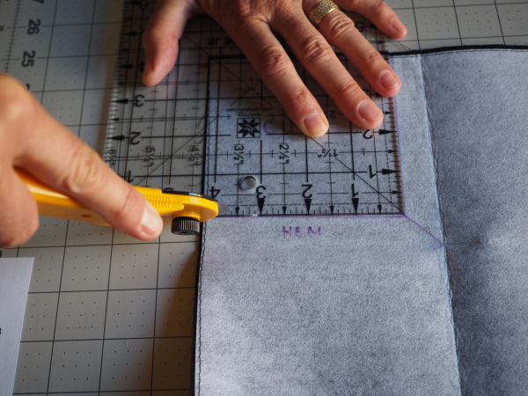
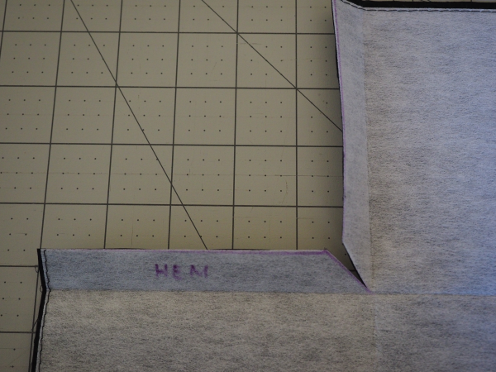
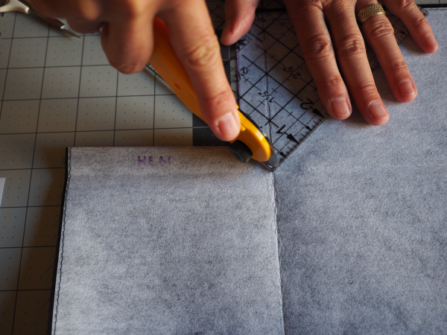
Cutting out the rear corners
Cut along each cut line
Then make a small diagonal 45° cut for folding
A small square ruler is helpful on this step.

Slide 9
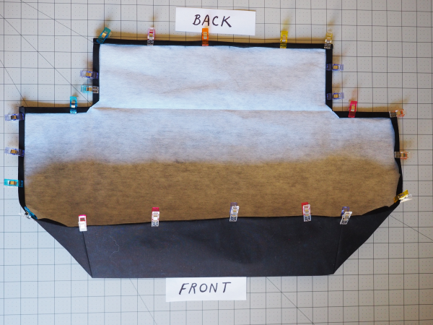
Sewing it up !
Fold all edges 1/4” and then 1/4” again
Secure edges with clips or pesky pins
Sew all edges
Flip right side out
You are done !

Slide 10
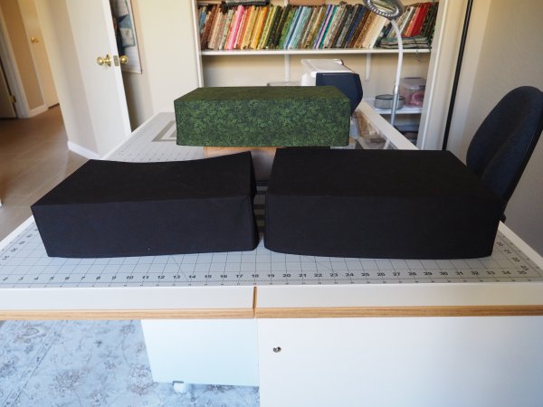
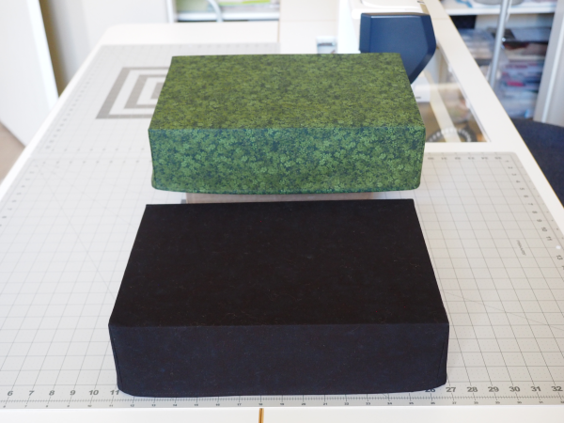
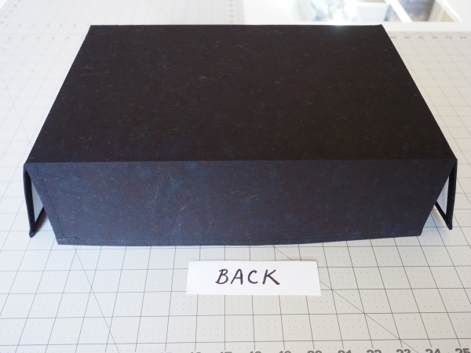
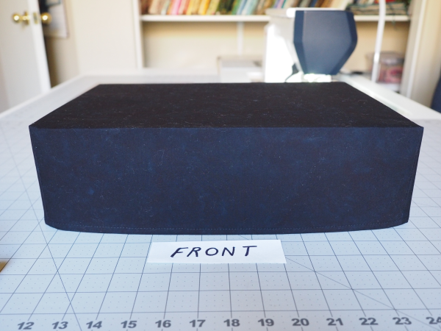
A few finished rig covers

